Slide 1


Understanding the new CMS Long-term care (LTC) survey process: effective 11/27/2017
May 3, 2018
Sonia Thomas, RN, BSN, SMQT
Facility Surveyor/Liaison
Health and Human Services (HHSC)
Regulatory Services Division, Region 6
E-mail: Sonia.thomas@hhsc.state.tx.us
Phone: 713-767-2411

Slide 2

Learning Objectives
At the end of this presentation, participants will be able to:
  Verbalize the “WHY” of long-term care (LTC) reform.
  List the phased in LTC survey implementation deadlines and their components.
  Understand the differences in the new survey process and provide an overview of the new survey process.
  Describe the new CMS Emergency Preparedness Rule – effective 11/15/2017.

Slide 3

The “Why” of LTC Reform
The revised regulations contain important consumer protections that were not included in the previous regulations
■ Greater focus on addressing a resident’s individual needs and preferences..
Notes:
Voting for ALF and NH residents – see the provider letter
Greater focus on addressing a resident’s individual needs and preferences. A nursing home must learn more about who the resident is as a person, provide greater support for resident preferences, and give residents increased control and choice.
■■Prompt development of a care plan. The original regulations allowed a resident to be without a care plan for as long as 21 days following admission. Now, a facility must develop and implement a care plan within 48 hours of a resident’s admission.
■■More comprehensive care. Treatment and services have been expanded to include pain management, dialysis, and behavioral health services.
■■Improved training. Training requirements have been expanded to apply to all staff, contractual employees, and volunteers. Mandatory topics include communication, residents’ rights, and prevention of abuse, neglect and exploitation. Training for nursing assistants is expanded to include dementia management and resident abuse prevention.
■■Improved protections against abuse, neglect and exploitation. A nursing home must not employ a licensed individual with a disciplinary action, and must report suspicions of a crime to law enforcement and the state survey and certification agency.
■■Better protection of resident property. Nursing homes are now required to take reasonable care of resident belongings and can no longer seek waivers of their responsibility for lost or stolen property. De-institutionalizes the nursing home environment.
Promotes Person-directed care

Slide 4
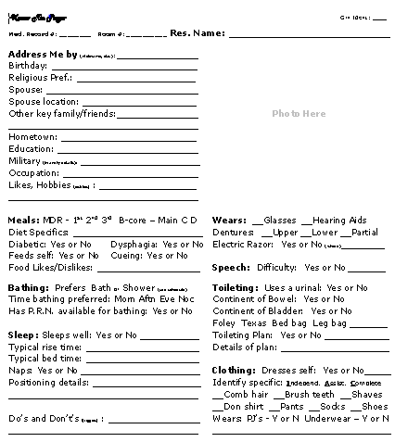
Know Me Form
Resident Needs & Preferences
From: National Nursing Home Quality Improvement Campaign
Notes:
Talk about person centered care
Consistent assignments
Voting
Pioneer Network

Slide 5
Look At Me… on Nursing Home Residents - YouTube video (3.5 minutes)
https://www.bing.com/videos/search?q=look+at+me+video+nursing+home&view=detail&mid=D5A8CB93A1242AFCBFD2D5A8CB93A1242AFCBFD2&FORM=VIRE
A resident in a nursing home reacts to hearing music from his past. He asks the questions:
  What do you see, nurses, what do you see?
  What are you thinking, when you look at me — A crabby old man, not very wise, Uncertain of habit, with far-away eyes,
  Look at me what do you see?

Slide 6
The “Why” LTC Reform (continued)
The revised regulations contain important consumer protections that were not included in the previous regulations
■ Prompt development of a care plan.
■ More comprehensive care.
■ Improved training.
■ Improved protections against abuse, neglect and exploitation.
■ Better protection of resident property.
Notes:
Greater focus on addressing a resident’s individual needs and preferences. A nursing home must learn more about who the resident is as a person, provide greater support for resident preferences, and give residents increased control and choice.
■■Prompt development of a care plan. The original regulations allowed a resident to be without a care plan for as long as 21 days following admission. Now, a facility must develop and implement a care plan within 48 hours of a resident’s admission.
■■More comprehensive care. Treatment and services have been expanded to include pain management, dialysis, and behavioral health services.
■■Improved training. Training requirements have been expanded to apply to all staff, contractual employees, and volunteers. Mandatory topics include communication, residents’ rights, and prevention of abuse, neglect and exploitation. Training for nursing assistants is expanded to include dementia management and resident abuse prevention.
■■Improved protections against abuse, neglect and exploitation. A nursing home must not employ a licensed individual with a disciplinary action, and must report suspicions of a crime to law enforcement and the state survey and certification agency.
■■Better protection of resident property. Nursing homes are now required to take reasonable care of resident belongings and can no longer seek waivers of their responsibility for lost or stolen property. De-institutionalizes the nursing home environment.
Promotes Person-directed care

Slide 7

Phased In Implementation Schedule
•Phase 1: Existing requirements, those requirements relatively straightforward to implement, and require minor changes to survey process. (November 28, 2016)
•Phase 2: All Phase 1 requirements, and those that providers need more time to develop, foundational elements, new survey process can assess compliance. (November 28, 2017)
Phase 3: All Phase 1 and 2, those requirements that need more time to implement (personnel hiring and training, implementation of systems approaches to quality).(November 28, 2019)
Notes:
Phased In Implementation Schedule
Regulation will be implemented in 3 phases.
•Phase 1: Existing requirements, those requirements relatively straightforward to implement, and require minor changes to survey process. (November 28, 2016)•Phase 2: All Phase 1 requirements, and those that providers need more time to develop, foundational elements, new survey process can assess compliance. (November 28, 2017)•Phase 3: All Phase 1 and 2, those requirements that need more time to implement (personnel hiring and training, implementation of systems approaches to quality).(November 28, 2019)
13

Slide 8
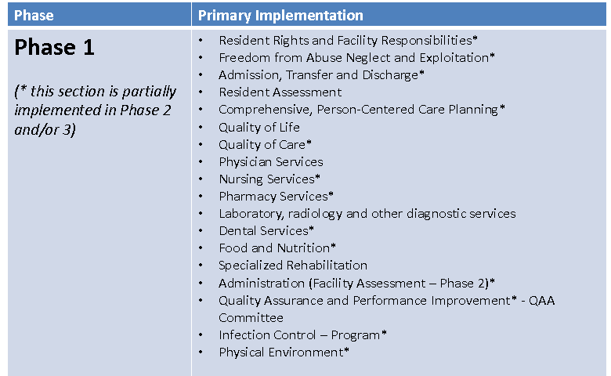
Phased Implementation

Slide 9
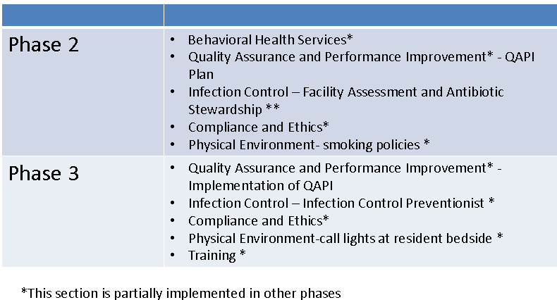
Phased Implementation (continued)

Slide 10

Overview of Regulation Reform
The regulation reform implements a number of pieces of legislation from the Affordable Care Act (ACA) and the Improving Medicare Post-Acute Care Transformation (IMPACT) Act, including the following:
Quality Assurance and Performance Improvement (QAPI)
Reporting suspicion of a crime
Increased discharge planning requirements
Staff training section

Slide 11
Phase 2 of LTC Regulations
Phase 2 includes but is not limited too:
Infection Control and Antibiotic Stewardship
Physical Environment – smoking policies
Resident Rights and Facility Responsibilities – Required Contact Information
Behavioral Health Services
Freedom from Abuse, Neglect, and Exploitation – 1150B
Admission, Transfer, and Discharge Rights – Transfer/Discharge Documentation

Slide 12
Phase 2 of LTC Regulations, continued
Phase 2 includes, but is not limited to:
Comprehensive Person-Centered Care Planning
Pharmacy Services – psychotropic medications
Dental Services – replacing dentures
Administration – Facility Assessment
Reference:
State Operations Manual (SOM) Appendix PP - Guidance to Surveyors for Long Term Care Facilities Table of Contents (Rev. 11-22-17)
Appendix PP State Operations Manual (Revised 11/22/2017) [PDF, 3MB]

Slide 13
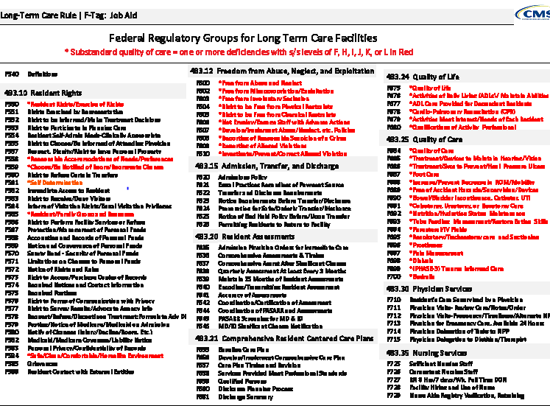
New F- Tag Renumbering &
New Regulations

Slide 14

Traditional Survey Process vs.
Current New Survey Process
Notes:
Now let’s switch topics and discuss the survey process. I’m first going to give a high level overview of the key differences between the current survey processes as compared to the new survey process.

Slide 15
Why did CMS Change the LTC Survey Process?
Two different survey processes existed to review the Requirements of Participation (Traditional and QIS)
The two processes appeared to identify slightly different quality of care/quality of life issues.
CMS set out to build on the best of both the Traditional and QIS processes to establish a single nationwide survey process

Slide 16

Goals of New Process
Same survey for entire country
Strengths from Traditional
& QIS
New innovative approaches
Effective and efficient
Resident-centered
Balance between structure and surveyor autonomy
Notes:
The New LTC Survey Process will replace both the Traditional and QIS processes, which means everyone in the country will use the same process. When designing the New LTC survey Process, they took into account the strengths from both the Traditional and QIS. One strength of the Traditional process was that surveyors could ask residents questions as they would like, which was retained in the New LTC Survey Process to promote surveyor autonomy. Having a computer-based process and using pathways as investigative tools were strengths of the QIS process that were used for the New LTC Survey Process. They also included many innovative ways of conducting various components of the survey.
The overarching goal for the New LTC Survey Process is to have one unified survey process that effectively identifies survey outcomes in an efficient manner that accounts for survey resources for both time spent onsite and the number of surveyors. The New LTC Survey Process is resident-centered, which means resident-specific concerns identified through resident observations and resident or representative interviews are emphasized. The New LTC Survey Process provides as much structure as possible to ensure consistency while allowing surveyors the autonomy to make decisions based on their expertise and judgment.

Slide 17

Automation
Traditional
New Survey Process
Survey team collects data and records the findings on paper
The computer is only used to prepare the deficiencies recorded on the CMS-2567
Each survey team member uses a tablet or laptop PC throughout the survey process to record findings that are synthesized and organized by new software

Slide 18

Sample Selection
Traditional
New Survey Process
Sample size determined by facility census
Residents are pre-selected based on QM/QI percentiles (total sample)
Sample may be adjusted based on issues identified on tour
Maximum sample size is 30 residents
Includes complaints
Sample size is determined by the facility census
70% of the total sample is MDS pre-selected residents and 30% of the total sample is surveyor-selected residents. Surveyors finalize the sample based on observations, interviews, and a limited record review.
Maximum sample size is 35 residents

Slide 19

Information Needed on Entrance
Traditional
New Survey Process
Roster Sample Matrix Form (CMS-802)
Completed matrix for new admissions over the last 30 days
Facility census number
Alphabetical list of residents
List of residents who smoke and designated smoking times (1 resident who smokes is required in the sample)

Slide 20
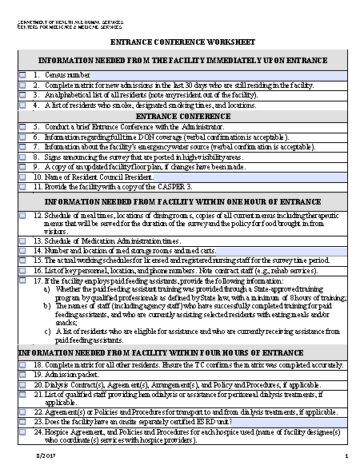
Updated Entrance Conference Worksheet

Slide 21
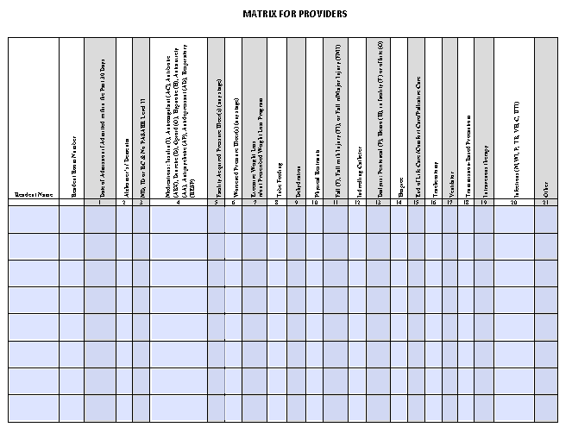
Updated Matrix for Providers

Slide 22
Initial Entry to Facility
Traditional
New Survey Process
Gather information about pre-selected residents and new concerns
Determine whether pre-selected residents are still appropriate
1 – 3 hours on average
No formal tour process
Surveyors complete a full observation, interview all interviewable residents, and complete a limited record review for initial pool residents:
  Offsite selected residents
  New admissions
  Vulnerable residents
  Identified Concern that doesn’t fall into one of the above subgroups
8 hours on average for interviews, observations, and screening.
Notes:
Unlike the previous survey processes, there is no formal tour for the new survey process. Surveyors will begin observing every resident in their assigned area to identify about eight residents for the initial pool process and then will spend about eight hours completing the observations, interviews and record review for the residents selected for the initial pool process.

Slide 23

Survey Structure
Traditional
New Survey Process
Resident sample is about 20% of facility census for resident observations, interviews, and record reviews
Phase I: Focused and comprehensive reviews based on QM/QI report and issues identified from offsite information and facility tour
Phase II: Focused record reviews
Facility and environmental tasks completed during the survey
Resident sample size is about 20% of facility census
Interview, observation and limited record review care areas are provided for the initial pool process;
Surveyors meet to discuss and select sample, may have more concerns than can be added to the sample; may need to prioritize concerns
Notes:
surveyors are completing thorough observations, interviews and a limited record review for the residents selected during the initial pool process. Part of that review consists of covering a number of quality of life and care areas and during interviews the surveyor can ask the questions as they would like as long as they maintain the intent of the area.
For the new survey process, the survey team will select the residents for the sample.

Slide 24

Survey Structure
Traditional
New Survey Process
Investigations are then completed during the remainder of the survey for each sample resident using Critical Element pathways
Facility tasks and closed record reviews are completed during the survey
Notes:
Once the sample is selected, the remainder of the survey is spent conducting investigations for residents, facility tasks and closed records.

Slide 25


N New LTC Survey Process
Inspection Protocol – for the new Survey Process:
Initial pool process
Sample Selection
Investigation
Notes:
The new survey process is computer-based with three parts:
The initial pool process
Sample selection
The investigative process

Slide 26
New LTC Survey Process –
Overview
Initial Pool Process
  Sample size based on census:
    70% offsite selected
    30% selected onsite by team:
      Vulnerable
      New Admissions
      Complaint
      FRI (Facility Reported Incidents- federal only)
      Identified concern
Notes:
There are three main parts to the New LTC Survey Process: the initial pool process, sample selection, and investigation.
The sample size is based on the facility census. Generally, the sample size is about 20% of the facility census. In some cases, the sample size is slightly higher than the numbers included in the Traditional sample size grid but lower than the sample size for QIS. One example is the cap for facilities with a census at or above 175 residents. The cap for the Traditional is set at 30 and the cap for QIS is set at 40. The New LTC Survey Process has a cap of 35 residents for larger facilities.
One of the most critical components to any survey is the sample. For the new survey process, 70% of the residents will be MDS pre-selected. The team will select 30% of the residents onsite, including vulnerable residents who are dependent on staff, new admissions within the last 30 days, complaints or facility-reported incidents or FRIs—which would cover any alleged violation involving mistreatment, neglect, abuse, injuries of unknown origin, and misappropriation of property—and any resident who has a significant concern but does not fall into any of the sub-groups I just mentioned.
The first day of the survey, or about eight hours, depending on when the team enters, is spent conducting observations, interviews, and a limited record review for the residents in the initial pool.

Slide 27
New LTC Survey Process –
Overview, continued
Select Sample
  Survey team selects sample
Investigations
  All concerns for sample residents requiring further investigation
    Closed records
    Facility tasks
Notes:
At the end of the first day or beginning of the second day, the survey team will identify the sample. Once the sample is selected, the remainder of the survey is spent investigating all concerns requiring further investigation for the residents in the sample. Facility tasks and closed-record investigations will also be conducted.
Majority of time spent observing and interviewing with relevant review of record to complete investigation
Use Appendix PP and critical elements (CE) pathways

Slide 28
New LTC Survey Process –
Overview, continued
Dining – First Full Meal
Surveyors will:
  Cover all dining rooms and room trays
  Observe enough to adequately identify concerns
  If concerns identified, observe another meal

Slide 29
New LTC Survey Process
Overview, continued
Sample Selection – Unnecessary Medication Review
The system selects five residents for full medication review
  Based on observation, interview, record review, and MDS
  Includes a broad range of high-risk medications and adverse consequences
Residents may or may not be in the sample
Notes:
The system will select five residents for an Unnecessary Medication review based on information entered by the surveyor during interviews, observations, record review, and information from the MDS.
The selection process considers all psychotropic medications, insulin, anticoagulants, opioids, diuretics and antibiotics, as well as some adverse consequences, including falls, weight loss, and sedation. There are exclusions; for example, a resident would be excluded if they had a diagnosis of Huntington’s or Schizophrenia and was receiving an antipsychotic.
The residents selected for the full medication review will include insulin, an anticoagulant, and an antipsychotic with Alzheimer’s or dementia, if available.

Slide 30
FREQUENTLY
ASKED
QUESTIONS

Slide 31
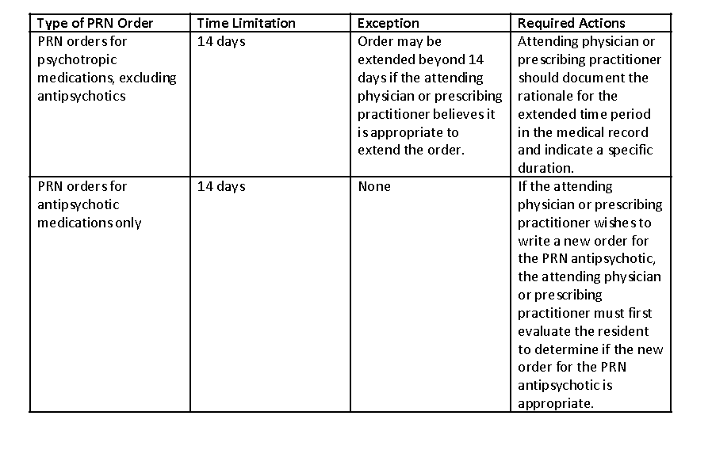
Pharmacy Services
§483.45 Pharmacy Services
From interpretive guidance at F757/F758
PRN anti-psychotics with Hospice Residents?
PRN anti-psychotics (specifically Haloperidol) have become a routine order by Hospice physicians. The hospice prn order may go unused for 14 days necessitating an in-person evaluation despite the desire by the physician to have this medication available to assist with potential symptoms of dying (delirium associated with hyperactivity at the end of life and it’s potent anti-emetic properties.

Slide 32
Pharmacy Services, cont’d
CMS Response
PRN anti-psychotics with Hospice Residents?
Good Hospice care, honoring resident’s choices and person-centered care, and Hospice clinical best practices all seem to conflict with this 14 day limit of PRN orders for anti-psychotic medications for person receiving hospice.
Question: Is there an exception to this rule?
We understand our concerns and appreciate the importance of promptly addressing the needs of all residents, especially those residents who receive end of life or hospice care.
There is no exception to the PRN antipsychotic requirement in the regulations. The intent of this requirement is to address the concern that the use of an anti-psychotic beyond the 14 days without physician evaluation of the resident could be detrimental to the resident. We are aware that the current Medicare Hospice requirements under 42 CFR 418.54 require updating of the comprehensive assessment every 15 days or more frequently as needed

Slide 33
§483.21 Comprehensive Resident Centered Care Plans
Question
Response
How can providers meet the 48 hour requirement for the base line care plan on the chart if admission occurs on the weekend?
The regulations do not specify how to create the Baseline Care Plan (BCP); Facilities will have to devise a process that ensures new admissions have their BCP done within the required 48 hours. It may be necessary for BCP to be developed over the course of several shifts
E.G., New admission at 11:40 pm on Friday –BCP complete by 11:40 pm on Sunday.

Slide 34
§483.21 Comprehensive Resident Centered Care Plans
Question
Response
What must be included in the Baseline Care Plan (BCP)?
483.21(a) states, “…The BCP must—
(ii) Include the minimum healthcare information necessary to properly care for a resident including, but not limited to –
(A) Initial goals based on admission orders
(B) Physician orders
(C) Dietary orders
(D) Therapy services
(E) Social services
(F) PASARR recommendation, if applicable”
It is expected that the admission orders will be used, along with information gathered by the admitting nurse, which will include input from the resident or representative.

Slide 35

§483.21 Comprehensive Resident Centered Care Plans
Question
Response
Is a verbal summary of the Baseline Care Plan (BCP) acceptable?
No.
The guidance at F-655 states, “The facility must provide the resident and the representative, if applicable, with a written summary of the baseline care plan…”

Slide 36
483.21 Comprehensive Resident Centered Care Plans
Question
Response
How long do we have to we have to give the family a written summary baseline care plan? I am aware the baseline care plan must be made in 48 hours but unclear how much time a written summary of plan to give to family?
At F655, the guidance states, “The facility must provide the resident and the representative, if applicable with a written summary of the baseline care plan by completion of the comprehensive care plan.” This means the resident or their representative must be provided a written summary before the completion of the comprehensive care plan.
Notes:
Additionally, if the comprehensive assessment identifies changes which would result in a different approach or goal on the comprehensive care plan, these changes must also be reflected in the summary. This is reflected in the following guidance, which goes on to say “Given that the baseline care plan is developed before the comprehensive assessment, it is possible that the goals and interventions may change. In the event that the comprehensive assessment and comprehensive care plan identified a change in the resident’s goals, or physical, mental, or psychosocial functioning, which was otherwise not identified in the baseline care plan, those changes must be incorporated into an updated summary provided to the resident and his or her representative, if applicable.”

Slide 37

§483.75 Quality Assurance & Performance Improvement (QAPI)
Question
Response
What needs to be in place now?
A QAA committee which –Is composed of:
  Director of Nurses;
  Medical Director (or designee); and
  3 other staff, one of which must be Administrator, owner, board member or other individual in leadership role.
  Infection Control & Prevention Officer -effective 11/28/19
Meets at least quarterly and as needed to:
  Identify which QAA activities are necessary, and
  Develop & implement appropriate plans of action to correct identified quality deficiencies.

Slide 38
§483.75 Quality Assurance & Performance Improvement (QAPI)
Question
Response
What changes will go into effect on November 28, 2017?
Present QAPI plan to state or federal surveyors -
  A QAPI Plan describes the process for conducting QAPI/QAA activities such as identifying and correcting quality deficiencies and opportunities for improvement
  The QAPI plan should be tailored to reflect the specific units, programs, departments, and unique population each facility services

Slide 39
§483.80 Infection Control
Question
Response
Does an Infection Preventionist (IP) have to be certified and by what date is this required?
The role and qualifications of the IP are effective November 28, 2019
•The IP must be qualified by education, training, experience or certification

Slide 40
§ 483.12 Freedom from Abuse, Neglect, and Exploitation
Question
Response
The scenario: A registered nurse received a disciplinary action on her license related to resident abuse back in 2011. She did whatever was called for to keep her license, and in 2017 she is still licensed, free and clear of any restrictions.
The question: Is the registered nurse banned under the new regulations from working at a nursing home, or does the usage of “in effect” mean that she can because the disciplinary action was back in 2011 and is no longer active?
If the disciplinary action is no longer in effect, 483.12(a)(3) (iii) would not prohibit that nurse from working at the facility. Also, the facility would still need to make sure the registered nurse had not “been found guilty of abuse, neglect, exploitation, misappropriation of property, or mistreatment by a court of law” or “had a finding entered into the State nurse aide registry concerning abuse, neglect, exploitation, mistreatment of residents or misappropriation of their property” per the requirements of 483.12(a)(3(i) and (ii).

Slide 41
§ 483.12 Freedom from Abuse, Neglect, and Exploitation
Question
Response
If a nurse that currently works for a facility has a disciplinary action on her license are we expected to terminate their employment based on the new regulation?
In order to meet the Federal requirement at 42 CFR 483.12(a)(3)(iii), a facility must not employ, or otherwise engage individuals, who have a disciplinary action in effect against his/her professional license as a result of a finding of abuse, neglect, exploitation, mistreatment of residents or misappropriation of resident property. If a facility employs a nurse where a probation is in effect on his/her nursing license, as a result of abuse, neglect, exploitation, mistreatment of residents or misappropriation of resident property, then the facility would not be in compliance with Federal requirements. We would encourage you to review the terms of the disciplinary action on the license status to determine this.

Slide 42
§ 483.12 Freedom from Abuse, Neglect, and Exploitation
Question
Response
When the regulation refers to reporting immediately but not later than 2 hours, is this reporting internally or externally? For example, does the agency have to report to the appropriate external agencies not later than 2 hours after the allegation is made?
According to 42CFR483.12(c)(1),reports must be made to the facility’s administrator and to the State Survey Agency and adult protective services where state law provides for jurisdiction in long-term care facilities and to other officials in accordance with State law.

Slide 43
§ 483.12 Freedom from Abuse, Neglect, and Exploitation
Question
Response
Which cases of abuse and neglect need to be reported within 2 hours? Within 24 hours?
1. If there an allegation of abuse?
1. If yes, then the facility must report immediately to the administrator, State Survey Agency, adult protective services and other officials in accordance with State law, but not later than 2 hours

Slide 44
§ 483.12 Freedom from Abuse, Neglect, and Exploitation
Question
Response
Is there a reasonable suspicion of a crime involving a resident suffering serious bodily injury?
If yes, then covered individuals must report immediately to the State Survey Agency and local law enforcement, but not later than two hours.

Slide 45
§ 483.12 Freedom from Abuse, Neglect, and Exploitation
Question
Response
What is the Definition of Serious Bodily Injury?
“Serious bodily injury” means an injury involving extreme physical pain; involving substantial risk of death; involving protracted loss or impairment of the function of a bodily member, organ, or mental faculty; requiring medical intervention such as surgery, hospitalization, or physical rehabilitation; or an injury resulting from criminal sexual abuse
Reference: Section 2011(19)(A) of the Social Security Act

Slide 46

§ 483.12 Freedom from Abuse, Neglect, and Exploitation
Question
Response
1. If there a reasonable suspicion of a crime not involving serious bodily injury?
2. If there an allegation that doesn’t involve serious bodily injury of neglect, misappropriation, exploitation, mistreatment, or injury of unknown source?
The following must be reported not later than 24 hours:
If yes, then covered individuals must report to the State Survey Agency and local law enforcement, not later than 24 hours
2. If yes, then the facility must report to the administrator, State Survey Agency, adult protective services and other officials in accordance with State law, not later than 24 hours.

Slide 47

Understanding the New Emergency Preparedness Final Rule
&
Training and Testing Requirements

Slide 48

Emergency Preparedness Rule
Effective: 11/15/2017
more consistent and comprehensive national regulatory approach to emergency planning and preparation
The rule “establishes national emergency preparedness requirements for Medicare and Medicaid participating providers and suppliers.
These regulations will help ensure:
  Providers and suppliers adequately plan for both natural and man-made disasters
  Adequate preparation to meet the needs of residents during disasters and emergency situations
  The health, safety and welfare of residents receiving care in an emergency situation.
  More consistent and comprehensive national regulatory approach to emergency planning and preparedness.

Slide 49
Emergency Preparedness Final Rule & Training and Testing Requirements
Develop and maintain training and testing programs, including initial training in policies and procedures.
Demonstrate knowledge of emergency procedures and provide training at least annually.
Conduct drills and exercises to test the emergency plan

Slide 50

Emergency Preparedness Final Rule &Training and Testing Requirements
Facilities are expected to meet all Training and Testing Requirements by the implementation date.
This means facilities are expected to have completed the following by 11/15/17:
All of the staff training requirements
Participation in a full-scale exercise that is community-based or when a community-based exercise is not accessible, an individual, facility-based exercise.

Slide 51
Training & Testing Requirements
This means facilities are expected to have completed the following by 11/15/2017:
Conduct an additional exercise that may include, but is not limited to the following:
  A second full-scale exercise that is individual, facility-based.
  A tabletop exercise that includes a group discussion led by a facilitator, using a narrated, clinically-relevant emergency scenario, and a set of problem statements, directed messages, or prepared questions designed to challenge an emergency plan.

Slide 52

Training & Testing Program Definitions
Facility-Based: When discussing the terms “all-hazards approach” and facility-based risk assessments, we consider the term “facility-based” to mean that the emergency preparedness program is specific to the facility. Facility-based includes, but is not limited to, hazards specific to a facility based on the geographic location; Patient/Resident/Client population; facility type and potential surrounding community assets (i.e. rural area versus a large metropolitan area).
Full-Scale Exercise: A full scale exercise is a multi-agency, multijurisdictional, multi-discipline exercise involving functional (for example, joint field office, emergency operation centers, etc.) and/or ‘‘boots on the ground’’ response (for example, firefighters decontaminating mock victims).

Slide 53
Training & Testing Program Definitions
Table-top Exercise (TTX): A table-top exercise is a group discussion led by a facilitator, using narrated, clinically-relevant emergency scenario, and a set of problem statements, directed messages, or prepared questions designed to challenge an emergency plan. It involves key personnel discussing simulated scenarios, including computer-simulated exercises, in an informal setting. TTXs can be used to assess plans, policies, and procedures.
State Operations Manual, Appendix Z- Emergency Preparedness for All Provider and Certified Supplier Types, Interpretive Guidance, Table of Contents, Issued 06-09-2017
https://www.cms.gov/Regulations-and-Guidance/Guidance/Manuals/downloads/som107ap_z_emergprep.pdf

Slide 54
Examples of Table Top Exercises or Full Scale Exercises
Earthquakes
Tornados
Hurricane
Flooding
Fires
Cyber Security Attack
Infectious Disease Outbreak
Active Shooter

Slide 55



Hurricane Harvey was “Epic”
Support came from many sources
  17,000 National Guard troops from 16 states
  The “Cajun Navy” went door to door in boats
  A furniture store opened for temporary shelter
  Churches opened their doors

Slide 56





Houston and surrounding area –
Historic Flooding - August 2017
Notes:
Hurricane Harvey dumped 27 trillion gallons of rain over Texas
One third of Houston was completely flooded and the weight of the water sank the city 2 centimeters temporarily
Flood waters were grossly contaminated
A quality was impacted by a chemical plant explosion triggered by toxic gas release
Two reservoirs in west Houston had water released to avoid catastrophe by flooded nearby communities

Slide 57
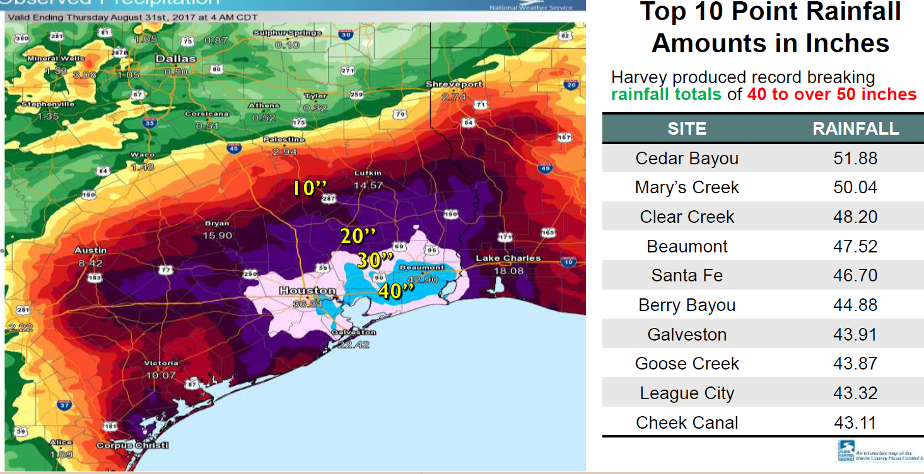
Hurricane Harvey Rain Impact

Slide 58


New LTC Emergency Preparedness Resource
Hilal Salami is the Emergency Preparedness Coordinator for Special Populations with the Southeast Texas Regional Advisory Council (SETRAC), which serves as the Department of State Health Services contractor for the Hospital Preparedness Program (HPP) grant.
Under his new role with SETRAC, Hilal will be leading the way to Special Populations coalition building including preparedness and planning initiatives, training and exercise guidance for Long Term Care facilities, Nursing Homes, Assisted Living Centers, Inpatient Mental health among others, within a 25-county jurisdiction across Southeast Texas.
Hilal Salami LP, BSc, HSO
Hilal can be contacted at 713-204-6468 or hilal.salami@setrac.org

Slide 59
Regional Healthcare Preparedness Coalition
Benefits of EMResource
EMResource
EMResource is an interoperable emergency and day to day communication system that streamlines communications required to prepare for, respond to, and recover from individual and large-scale disasters for the entire emergency services and healthcare spectrum.
Ability to view type and availability of beds in long term care facilities during an emergency or disaster
Utilize the system to participate in drills and exercises to prepare your staff for a real-world event

Slide 60

ASPR RESOURCES ON FLOODING
Definitions:
  ASPR is the United States Department of Human Services Office of the Assistant Secretary for Preparedness & Response.
      ASPR TRACIE: https://asprtracie.hhs.gov/
  TRACIE is the Technical Resources Assistance Center and Information Exchange.
Some areas in the United States are experiencing flooding due to late winter storms. These resources can help you prepare for and respond to floods:
.

Slide 61

ASPR RESOURCES ON FLOODING
The Natural Disasters Topic Collection
Website: https://asprtracie.hhs.gov/technical-resources/36/natural-disasters/27
Lessons Learned from Flooding Events
Website: https://asprtracie.hhs.gov/technical-resources/36/natural-disasters/27#lessons-learned-floods-and-landslides)
After the Flood: Mold Specific Resources Includes information on cleaning up after floods and preventing, identifying, and getting rid of mold
Website: https://asprtracie.s3.amazonaws.com/documents/after-the-flood-mold-specific-resources.pdf

Slide 62


CONTACT
If you have questions or need additional information, contact:
Mark Kendall, HHSC, Regional Director: 713-767-2293
E-mail: mark.kendall@hhsc.state.tx.us
Phone: 713-767-2291
Mark Kendall, HHSC
Mark Smith, LSC Program Manager: 713-767-2293
E-mail: mark.smith@hhsc.state.tx.us
Phone: 713-767-2293
Main number and to contact your facility assigned
Geriatric Program Manager
Call: 713-767-2200
Notes:
[Review slide.]

Slide 63

QUESTIONS

Slide 64


